Slide 1
K. NARAYANAN
MARKETS AND COMPETITION

Slide 2
MARKETS AND COMPETITION
Supply and demand are the two words that economists use most often.
Supply and demand are the forces that make market economies work.
Modern microeconomics is about supply, demand, and market equilibrium.
Notes:
2

Slide 3

What Is a Market?
A market is a group of buyers and sellers of a particular good or service.
The terms supply and demand refer to the behavior of people . . . as they interact with one another in markets.
Notes:
4

Slide 4

What Is a Market?
Buyers determine demand.
Sellers determine supply.
Notes:
4

Slide 5
What Is Competition?
A competitive market is a market in which there are many buyers and sellers so that each has a negligible impact on the market price.
Notes:
5

Slide 6
What Is Competition?
Competition: Perfect and Otherwise
  Perfect Competition
    Products are the same
    Numerous buyers and sellers so that each has no influence over price
    Buyers and Sellers are price takers
  Monopoly
    One seller, and seller controls price
Notes:
6

Slide 7
What Is Competition?
Competition: Perfect and Otherwise
  Oligopoly
    Few sellers
    Not always aggressive competition
  Monopolistic Competition
    Many sellers
    Slightly differentiated products
    Each seller may set price for its own product
Notes:
6

Slide 8
DEMAND
Quantity demanded is the amount of a good that buyers are willing and able to purchase.
Law of Demand
  The law of demand states that, other things equal, the quantity demanded of a good falls when the price of the good rises.
Notes:
8

Slide 9
The Demand Curve: The Relationship between Price and Quantity Demanded
Demand Schedule
  The demand schedule is a table that shows the relationship between the price of the good and the quantity demanded.
Notes:
17

Slide 10
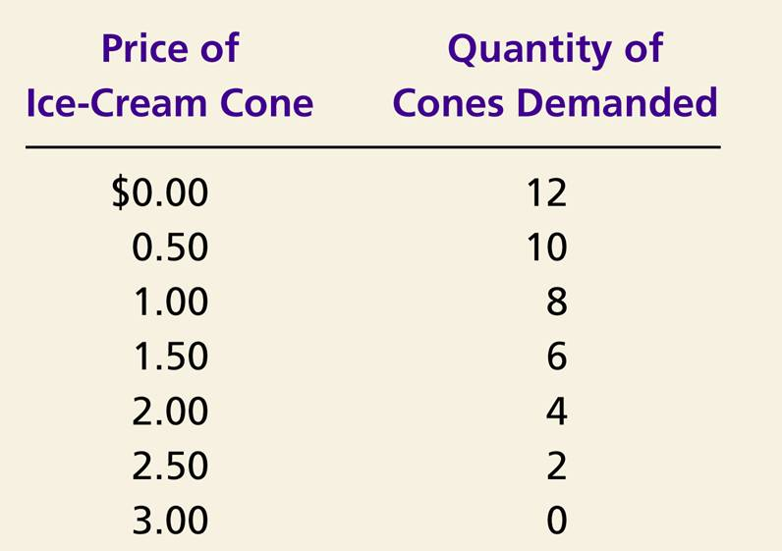
Catherine’s Demand Schedule
Notes:
17

Slide 11
The Demand Curve: The Relationship between Price and Quantity Demanded
Demand Curve
  The demand curve is a graph of the relationship between the price of a good and the quantity demanded.
Notes:
17

Slide 12
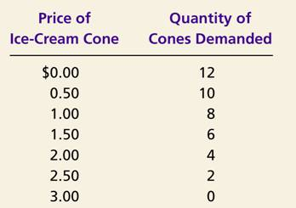
Figure 1 Catherine’s Demand Schedule and Demand Curve
Price of
Ice-Cream Cone
$3.00
2.50
1. A decrease
2.00
in price
...
1.50
1.00
0.50
0
1
2
3
4
5
6
7
8
9
10
11
12
Quantity of
Ice-Cream Cones
2.
...
increases quantity
of cones demanded.

Slide 13
Market Demand versus Individual Demand
Market demand refers to the sum of all individual demands for a particular good or service.
Graphically, individual demand curves are summed horizontally to obtain the market demand curve.

Slide 14
The Market Demand Curve
When the price is $2.00, Catherine will demand 4 ice-cream cones.
When the price is $2.00, Nicholas will demand 3 ice-cream cones.
The market demand at $2.00 will be 7 ice-cream cones.
The market demand curve is the horizontal sum of the individual demand curves!
Catherine’s Demand
+
Nicholas’s Demand
=
Market Demand
Price of Ice-Cream Cone
Price of Ice-Cream Cone
Price of Ice-Cream Cone
2.00
2.00
2.00
1.00
1.00
1.00
4
8
3
5
7
13
Quantity of Ice-Cream Cones
Quantity of Ice-Cream Cones
Quantity of Ice-Cream Cones
When the price is $1.00, Catherine will demand 8 ice-cream cones.
When the price is $1.00, Nicholas will demand 5 ice-cream cones.
The market demand at $1.00, will be 13 ice-cream cones.

Slide 15
Shifts in the Demand Curve
Change in Quantity Demanded
  Movement along the demand curve.
  Caused by a change in the price of the product.
Notes:
19

Slide 16
Changes in Quantity Demanded
A tax on sellers of ice-cream cones raises the price of ice-cream cones and results in a movement along the demand curve.
Price of Ice-Cream
Cones
B
$2.00
A
1.00
D
0
4
8
Quantity of Ice-Cream Cones

Slide 17
Shifts in the Demand Curve
  Consumer income
  Prices of related goods
  Tastes
  Expectations
  Number of buyers
Notes:
11

Slide 18
Shifts in the Demand Curve
Change in Demand
  A shift in the demand curve, either to the left or right.
  Caused by any change that alters the quantity demanded at every price.
Notes:
19

Slide 19
Figure 3 Shifts in the Demand Curve
Price of
Ice-Cream
Cone
Increase
in demand
Decrease
in demand
Demand
curve,
D
2
Demand
curve,
D
1
Demand curve,
D
3
0
Quantity of
Ice-Cream Cones

Slide 20
Shifts in the Demand Curve
Consumer Income
  As income increases the demand for a normal good will increase.
  As income increases the demand for an inferior good will decrease.

Slide 21
Consumer Income Normal Good
Price of Ice-Cream Cone
$3.00
An increase in income...
2.50
Increase
in demand
2.00
1.50
1.00
0.50
D₂
D₁
Quantity of Ice-Cream Cones
0
1
2
3
4
5
6
7
8
9
10
11
12

Slide 22
Consumer Income Inferior Good
Price of Ice-Cream Cone
$3.00
2.50
An increase in income...
2.00
Decrease
in demand
1.50
1.00
0.50
D₂
D₁
Quantity of Ice-Cream Cones
0
1
2
3
4
5
6
7
8
9
10
11
12

Slide 23
Shifts in the Demand Curve
Prices of Related Goods
  When a fall in the price of one good reduces the demand for another good, the two goods are called substitutes.
  When a fall in the price of one good increases the demand for another good, the two goods are called complements.

Slide 24
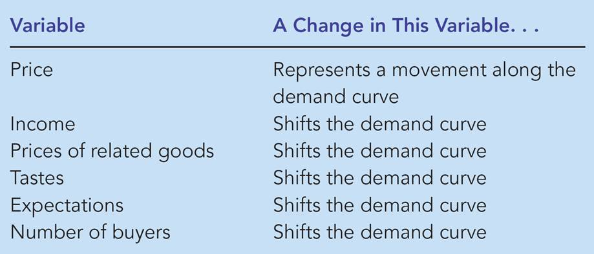
Table 1 Variables That Influence Buyers

Slide 25
SUPPLY
Quantity supplied is the amount of a good that sellers are willing and able to sell.
Law of Supply
  The law of supply states that, other things equal, the quantity supplied of a good rises when the price of the good rises.
Notes:
25

Slide 26
The Supply Curve: The Relationship between Price and Quantity Supplied
Supply Schedule
  The supply schedule is a table that shows the relationship between the price of the good and the quantity supplied.
Notes:
29

Slide 27
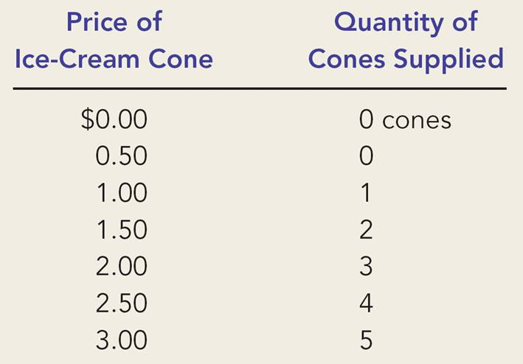
Ben’s Supply Schedule
Notes:
29

Slide 28
The Supply Curve: The Relationship between Price and Quantity Supplied
Supply Curve
  The supply curve is the graph of the relationship between the price of a good and the quantity supplied.
Notes:
29

Slide 29
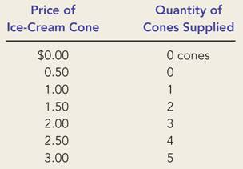
Figure 5 Ben’s Supply Schedule and Supply Curve
Price of
Ice-Cream
Cone
$3.00
2.50
1. An
increase
in price
...
2.00
1.50
1.00
0.50
0
1
2
3
4
5
6
7
8
9
10
11
12
Quantity of
Ice-Cream Cones
2.
...
increases quantity of cones supplied.

Slide 30
Market Supply versus Individual Supply
0
Market supply refers to the sum of all individual supplies for all sellers of a particular good or service.
Graphically, individual supply curves are summed horizontally to obtain the market supply curve.

Slide 31
Shifts in the Supply Curve
0
Input prices
Technology
Expectations
Number of sellers
Notes:
27

Slide 32
Shifts in the Supply Curve
0
Change in Quantity Supplied
  Movement along the supply curve.
  Caused by a change in anything that alters the quantity supplied at each price.
Notes:
30

Slide 33
Change in Quantity Supplied
0
Price of Ice-Cream Cone
S
C
$3.00
A rise in the price of ice cream cones results in a movement along the supply curve.
A
1.00
Quantity of Ice-Cream Cones
0
1
5
Notes:
30

Slide 34
Shifts in the Supply Curve
0
Change in Supply
  A shift in the supply curve, either to the left or right.
  Caused by a change in a determinant other than price.
Notes:
30

Slide 35
Figure 7 Shifts in the Supply Curve
0
Price of
Ice-Cream
Supply curve,
S
3
Supply
Cone
curve,
S
1
Supply
Decrease
curve,
S
2
in supply
Increase
in supply
0
Quantity of
Ice-Cream Cones

Slide 36
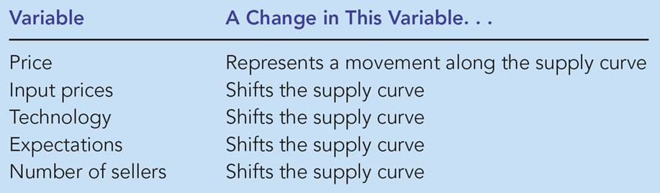
Table 2: Variables That Influence Sellers
0

Slide 37
SUPPLY AND DEMAND TOGETHER
Equilibrium refers to a situation in which the price has reached the level where quantity supplied equals quantity demanded.
Notes:
36

Slide 38
SUPPLY AND DEMAND TOGETHER
Equilibrium Price
  The price that balances quantity supplied and quantity demanded.
  On a graph, it is the price at which the supply and demand curves intersect.
Equilibrium Quantity
  The quantity supplied and the quantity demanded at the equilibrium price.
  On a graph it is the quantity at which the supply and demand curves intersect.
Notes:
36

Slide 39
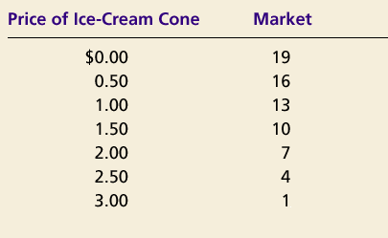
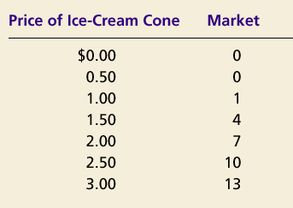
SUPPLY AND DEMAND TOGETHER
Demand Schedule
Supply Schedule
At $2.00, the quantity demanded is equal to the quantity supplied!
Notes:
36

Slide 40
Figure 8 The Equilibrium of Supply and Demand
Price of
Ice-Cream
Cone
Supply
Equilibrium price
Equilibrium
$2.00
Equilibrium
Demand
quantity
0
1
2
3
4
5
6
7
8
9
10
11
12
13
Quantity of Ice-Cream Cones

Slide 41
Equilibrium
Surplus
  When price > equilibrium price, then quantity supplied > quantity demanded.
    There is excess supply or a surplus.
    Suppliers will lower the price to increase sales, thereby moving toward equilibrium.

Slide 42
Figure 9 Markets Not in Equilibrium
(a) Excess Supply
Price of
Ice-Cream
Supply
Cone
Surplus
$2.50
2.00
Demand
0
4
7
10
Quantity of
Quantity
Quantity
Ice-Cream
demanded
supplied
Cones

Slide 43
Equilibrium
Shortage
  When price < equilibrium price, then quantity demanded > the quantity supplied.
    There is excess demand or a shortage.
    Suppliers will raise the price due to too many buyers chasing too few goods, thereby moving toward equilibrium.

Slide 44
Figure 9 Markets Not in Equilibrium
(b) Excess Demand
Price of
Ice-Cream
Supply
Cone
$2.00
1.50
Shortage
Demand
0
4
7
10
Quantity of
Quantity
Quantity
Ice-Cream
supplied
demanded
Cones

Slide 45
Equilibrium
Law of supply and demand
  The claim that the price of any good adjusts to bring the quantity supplied and the quantity demanded for that good into balance.

Slide 46
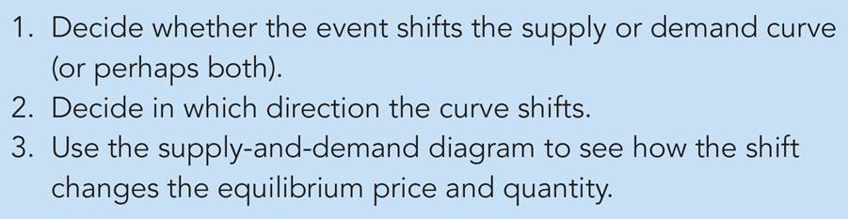
Table 3: Three Steps for Analyzing Changes in Equilibrium

Slide 47
Figure 10 How an Increase in Demand Affects the Equilibrium
Price of
Ice-Cream
1. Hot weather increases
Cone
the demand for ice cream . . .
Supply
$2.50
New equilibrium
2.00
2. . . . resulting
Initial
in a higher
equilibrium
price . . .
D
D
0
7
10
Quantity of
3.
. . .
and a higher
Ice-Cream Cones
quantity sold.

Slide 48
Three Steps to Analyzing Changes in Equilibrium
Shifts in Curves versus Movements along Curves
  A shift in the supply curve is called a change in supply.
  A movement along a fixed supply curve is called a change in quantity supplied.
  A shift in the demand curve is called a change in demand.
  A movement along a fixed demand curve is called a change in quantity demanded.

Slide 49
Figure 11 How a Decrease in Supply Affects the Equilibrium
Price of
Ice-Cream
1. An increase in the
Cone
price of sugar reduces
S₂
the supply of ice cream. . .
S₁
New
$2.50
equilibrium
2.00
Initial equilibrium
2. . . . resulting
in a higher
price of ice
cream . . .
Demand
0
4
7
Quantity of
3.
. . .
and a lower
Ice-Cream Cones
quantity sold.

Slide 50
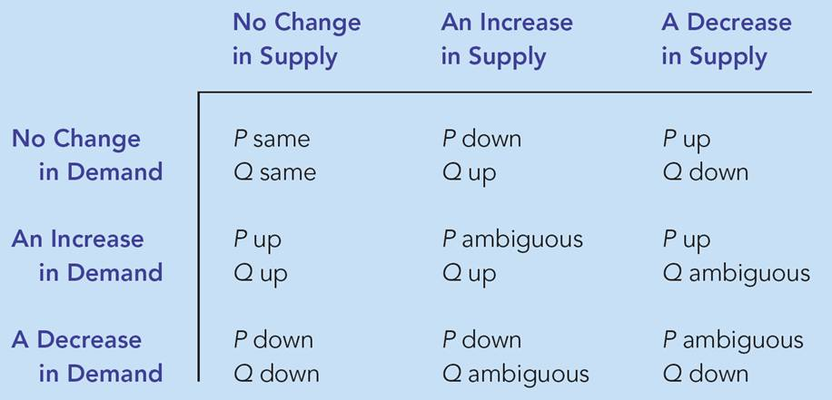
Table 4: What Happens to Price and Quantity When Supply or Demand Shifts?

Slide 51
Economists use the model of supply and demand to analyze competitive markets.
In a competitive market, there are many buyers and sellers, each of whom has little or no influence on the market price.

Slide 52
The demand curve shows how the quantity of a good depends upon the price.
  According to the law of demand, as the price of a good falls, the quantity demanded rises. Therefore, the demand curve slopes downward.
  In addition to price, other determinants of how much consumers want to buy include income, the prices of complements and substitutes, tastes, expectations, and the number of buyers.
  If one of these factors changes, the demand curve shifts.

Slide 53
The supply curve shows how the quantity of a good supplied depends upon the price.
  According to the law of supply, as the price of a good rises, the quantity supplied rises. Therefore, the supply curve slopes upward.
  In addition to price, other determinants of how much producers want to sell include input prices, technology, expectations, and the number of sellers.
  If one of these factors changes, the supply curve shifts.

Slide 54
Market equilibrium is determined by the intersection of the supply and demand curves.
At the equilibrium price, the quantity demanded equals the quantity supplied.
The behavior of buyers and sellers naturally drives markets toward their equilibrium.

Slide 55
To analyze how any event influences a market, we use the supply-and-demand diagram to examine how the event affects the equilibrium price and quantity.
In market economics, prices are the signals that guide economic decisions and thereby allocate resources.

